Slide 1
kayon
DESIGNS LTD
Construction Logistics Planning
& Planning Consultancy
Practical strategies. Faster approvals. Buildable solutions.
PLANNING
LOGISTICS
PRE-CONSTRUCTION
KAYON
London | Supporting developers, contractors, project managers and consultants
BUILDABLE. COMPLIANT. EFFICIENT.

Slide 2
“
Our role is to bridge the gap between what is agreed at planning and what is realistically required to deliver the project.
We combine planning compliance with real construction experience - turning conditions, constraints and stakeholder requirements into practical strategies that work on site.
PLANNING FOCUS. DELIVERY SUCCESS.

Slide 3
ABOUT US
Construction thinking from the client’s perspective.
A specialist consultancy focused on construction logistics, planning compliance and pre-construction support.
Kayon Designs supports projects from early planning through to delivery. We work collaboratively with developers, planning consultants, project managers and contractors to identify constraints early, develop proportionate mitigation and produce documentation that is clear, technically robust and practical to implement.
Practical
Responsive
2.25
2.25
Collaborative
Delivery-led
Our strength is the interface between planning requirements and construction reality - particularly site access, public highway constraints, vehicle movements, delivery management, temporary traffic arrangements and construction sequencing.
2.25
2.25
Over 90% first-time approval success on relevant submissions*
*Based on project experience and submissions to date.

Slide 4
OUR APPROACH
Advice that is practical, proportionate and buildable.
01
02
03
04
05
Understand
Test
Coordinate
Submit
Close out
Planning conditions, site constraints, programme and stakeholders.
Access, vehicle movements, servicing, phasing and temporary arrangements.
Align the logistics strategy with design, planning and construction methodology.
Prepare clear technical documentation for client and authority review.
Respond quickly to comments and support condition discharge / approval.
Hands-on involvement | Agile response | Early risk identification | Effective stakeholder engagement | Cost-conscious solutions

Slide 5
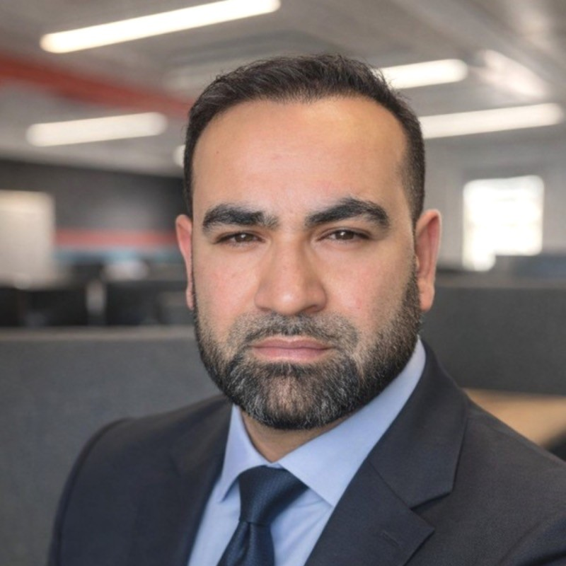
LEADERSHIP
Experienced across planning, pre-construction and delivery.
Kaysar Alim
KA
Founder | Construction Logistics & Planning Consultant
A construction logistics and pre-construction professional with experience spanning work winning, planning, construction delivery, stakeholder coordination and major project logistics. This combination allows Kayon to approach planning documentation from a buildability perspective rather than treating each condition in isolation.
Major commercial, mixed-use, infrastructure and data centre experience
Strong interface knowledge between construction activity and the public highway
AutoCAD vehicle tracking, swept-path and access planning capability
Tender, work-winning and operational delivery experience

Slide 6
OUR SERVICES
Support across the development lifecycle.
From early planning and condition discharge to tender support and live construction logistics.
PLANNING SUPPORT
ACCESS & MOVEMENT
DELIVERY SUPPORT
CMP | CEMP | CLP
CONDITION DISCHARGE
Swept Paths | Routing
PRE-CONSTRUCTION
Reviews | Updates | Advice
CTMP | SMP | SWMP
Tender | Logistics Strategy

Slide 7
PLANNING & TECHNICAL SUPPORT
Clear submissions that help projects progress.
Construction Management Plans (CMP)
Construction Logistics Plans (CLP)
Construction Traffic Management Plans (CTMP)
Construction Environmental Management Plans (CEMP)
Materials Management Plans (MMP)
Site Waste Management Plans (SWMP)
Servicing / Delivery Management Plans
Planning Condition Discharge Support
Objective: satisfy planning requirements without losing sight of programme, procurement, logistics demand, site establishment and construction sequencing.

Slide 8
ACCESS, TRAFFIC & VEHICLE MOVEMENT
Solving the interface between the site and the public highway.
A recurring challenge on constrained developments is proving that construction traffic can access, service and leave the site safely without creating unacceptable impacts on pedestrians, cyclists, neighbours or the highway network.
RIGID
Swept Path Analysis & Vehicle Tracking
Site Access Strategies
Delivery Routing Plans
Traffic Management Plans
Pedestrian Management Plans
Highway / licence application support
Loading, bay suspension and servicing reviews
Vehicle path / turning envelope

Slide 9
TENDER & PRE-CONSTRUCTION SUPPORT
Strengthening bids with practical logistics thinking.
Project constraints
Logistics methodology
Tender submissions
01
02
03
Review access, neighbours, highway, programme and operational constraints.
Develop a credible delivery strategy aligned to the construction sequence.
Provide technical responses, diagrams and narrative for bid documentation.
Site establishment
Delivery planning
Design coordination
04
05
06
Test gates, hoists, cranes, welfare, storage and material movement strategies.
Estimate logistics demand, vehicle types, booking controls and peak movements.
Identify interfaces early and feed logistics requirements back into design.

Slide 10
WHO WE SUPPORT
Flexible specialist resource for project teams.
Developers
Project Managers
Planning Consultants
PARTNER MODEL
PARTNER MODEL
PARTNER MODEL
Planning submissions, condition discharge, access and construction strategy.
Associate / overflow resource and technical logistics input.
Specialist documents and condition discharge support for client teams.
Main Contractors
Architects
Transport Consultants
PARTNER MODEL
PARTNER MODEL
PARTNER MODEL
Tender logistics, methodology, mobilisation and live project reviews.
Early access, servicing and buildability input to support design development.
Construction-stage logistics expertise and vehicle tracking support.

Slide 11
SECTOR EXPERIENCE
Complex projects. Constrained environments. Practical delivery.
Commercial
Residential & Mixed Use
Data Centres
Central London offices and high-density urban schemes
Multi-phase residential and regeneration projects
High-volume logistics, constrained programmes and specialist delivery
Infrastructure
Retail & Leisure
Education & Institutional
Highway interfaces, major stakeholder environments and public realm
Operational interfaces, public access and servicing constraints
Live environments, safeguarding and phased delivery

Slide 12
SELECTED EXPERIENCE
Major London developments and complex logistics environments.
The Shard
Paddington Square
White Collar Factory
LONDON BRIDGE
WESTMINSTER
OLD STREET
Major central London development experience with complex logistics, access and stakeholder interfaces.
High-density city-centre project experience with significant highway, pedestrian and servicing constraints.
Commercial development experience in a constrained urban environment with intensive construction logistics requirements.
Westfield London
Westfield Stratford City
Olympic Media Centre
SHEPHERD’S BUSH
STRATFORD
STRATFORD
Large-scale retail development experience involving complex delivery, stakeholder and operational interfaces.
Major mixed-use / retail development with significant construction logistics and infrastructure interfaces.
Major programme experience in a high-profile, multi-stakeholder construction environment.

Slide 13
RECENT & SPECIALIST EXPERIENCE
From planning condition discharge to live logistics strategy.
Large-scale Data Centres
Whitechapel Road
Headley Court
UK & EUROPE
LONDON
SURREY
Logistics planning, work winning and delivery support for high-intensity, programme-critical developments.
Construction logistics planning with TfL / cycle infrastructure interface and servicing constraints.
Traffic management, access, delivery controls and waste planning across a complex campus environment.
One Milton Avenue
One Fleet Place
St James’s Square
CAMBRIDGE
CITY OF LONDON
WESTMINSTER
Gate strategy, vehicle tracking and logistics testing for a constrained multi-gate construction site.
Hoist and delivery logistics planning for a constrained commercial development.
Pit-lane logistics, delivery controls, temporary operations and constrained central London access planning.

Slide 14
HOW WE CAN SUPPORT
A flexible consultancy model built around project needs.
Fixed-fee commissions
Associate consultancy
ENGAGEMENT 01
ENGAGEMENT 02
Defined technical deliverables such as CMPs, CLPs, CTMPs, swept paths and servicing plans.
Embedded specialist support for project managers, planners and consultants when extra capability is required.
Day-rate support
Overflow / white-label support
ENGAGEMENT 03
ENGAGEMENT 04
Flexible resource for tender, pre-construction, technical reviews and project workshops.
Additional capacity for consultancies that need logistics expertise without increasing permanent headcount.
Responsive support. Clear scope. Practical outputs.

Slide 15
KAYON DESIGNS LTD
Construction Logistics Planning & Planning Consultancy
LET’S TALK
Buildable. Compliant. Efficient.
Kaysar Alim
Founder
Kayon Designs Ltd
London, UK
Email: Kaysar.alim@gmail.com
Mobile: 07908427865
LinkedIn: www.linkedin.com/in/kaysar-alim-9b5b5967
Supporting developers, contractors, project managers and consultants from planning through to delivery.
Construction Management Plans | Construction Logistics Plans | CTMPs | CEMPs | Swept Paths | Access Strategies | Planning Condition Discharge | Tender Support
KAYON DESIGNS LTD

